Slide 1



Adventure Works
By,
Anshul Dipak Funde
anshulfunde1671@gmail.com
https://www.linkedin.com/in/anshul-funde-1386261a4/
https://github.com/anshulfunde

Slide 2

Introduction
Adventure Works Cycles is large , multinational manufacturing company specializing in metal and composite bicycles.
Its primary markets include North America, Europe, and Asia.
The company is based in Bothell, Washington, with 290 employees, and it operates regional sales teams across its market areas

Slide 3

Project Overview
Objective : Analyze sales data to uncover key insights using Tableau, Power BI, Excel, and MySQL.
Data Processing:
Power Query was used for data cleaning and transformation.
SQL Queries were written in MySQL, mirroring report calculations to validate results across platforms.
KPIs Tracked:
Total Sales, Total Profit, Total Production Cost
Total Order Count, Total Order Quantity
Insights & Visualizations:
Time-based trends: Monthly, Quarterly, Yearly Sales
Geographical insights: Country & Region-wise Sales
Customer segmentation: Gender & Customer-wise Sales
Product performance: Best-selling products
This analysis ensures accuracy across platforms and helps optimize sales strategies.

Slide 4

KPI’s and Insights
In the Adventure Works dataset, key performance indicators (KPIs) typically include total sales, total profit, total production cost , total order count , total order quantity.
Insights derived from these KPIs can reveal trends in product popularity, sales performance by region, profitable product categories, and areas for improvement in customer acquisition and retention.

Slide 5
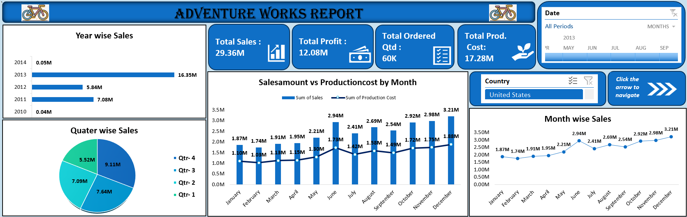
EXCEL REPORT

Slide 6
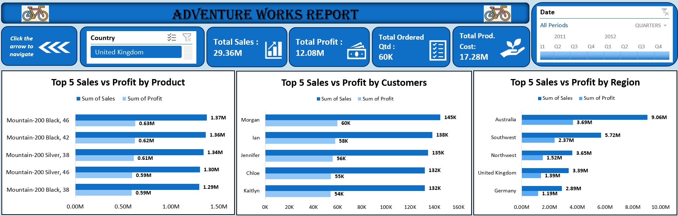
EXCEL REPORT

Slide 7
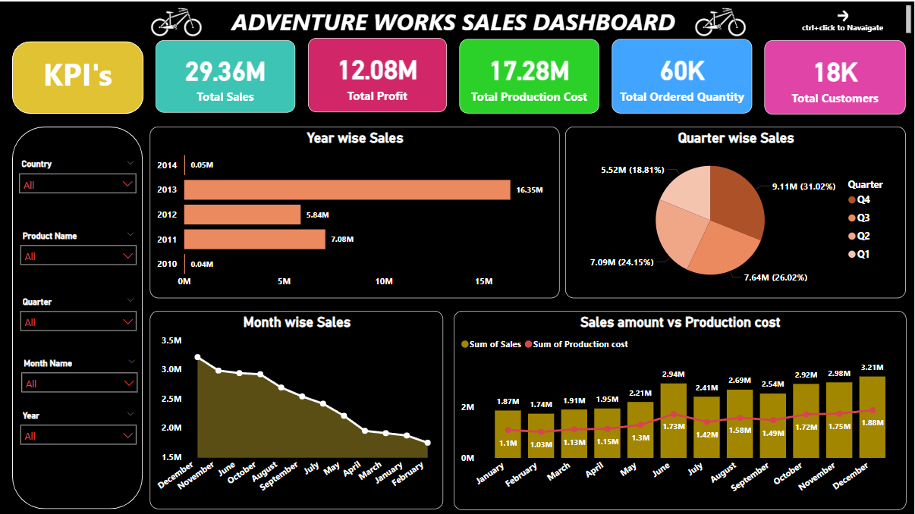
POWER BI REPORT

Slide 8
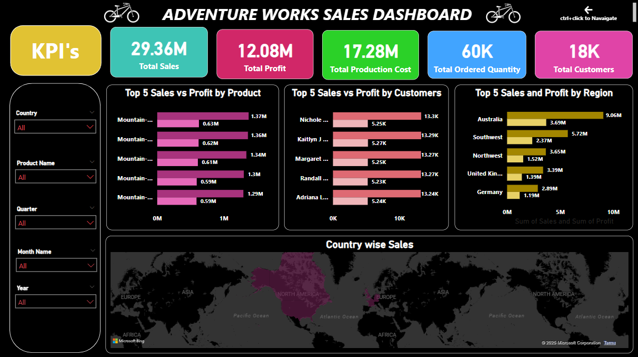
POWER BI REPORT

Slide 9
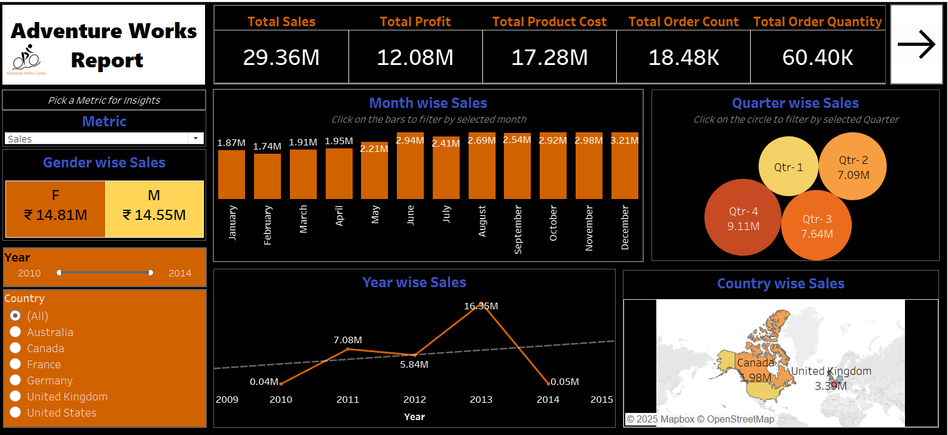
TABLEAU REPORT

Slide 10
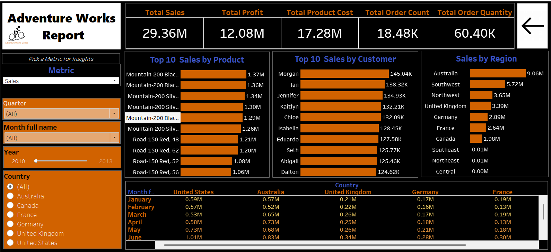
TABLEAU REPORT

Slide 11
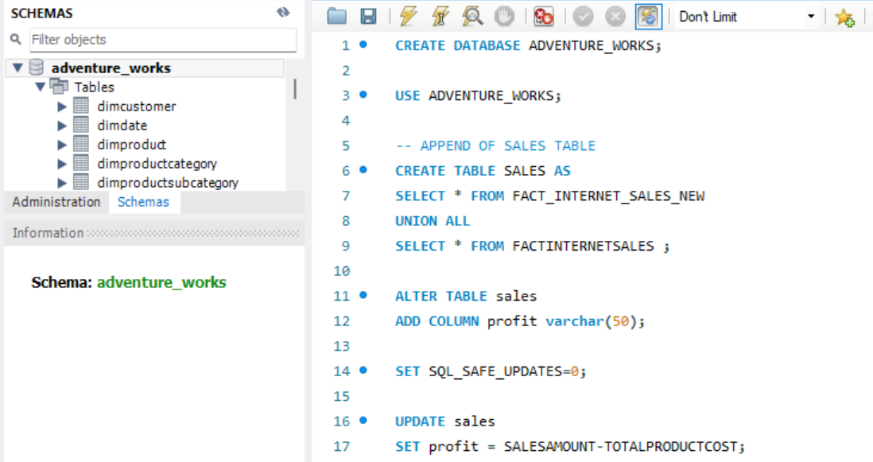
SQL QUERIES

Slide 12
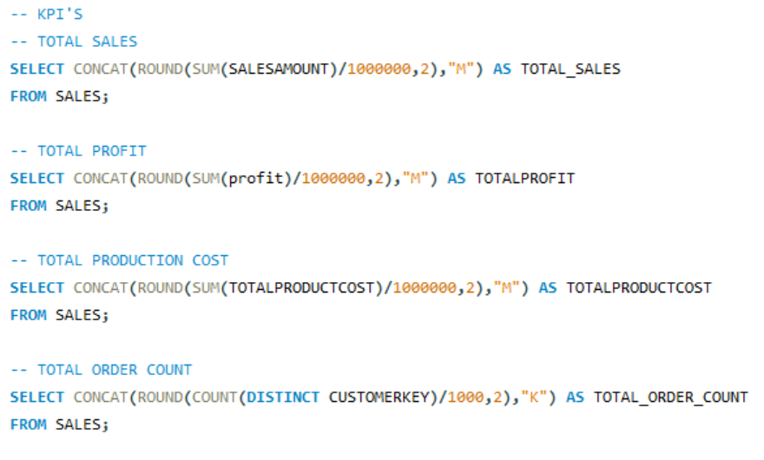
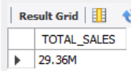
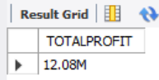
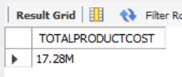
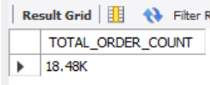
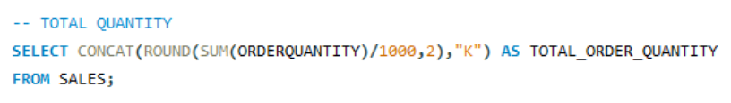
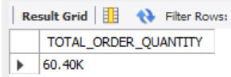
SQL QUERIES

Slide 13
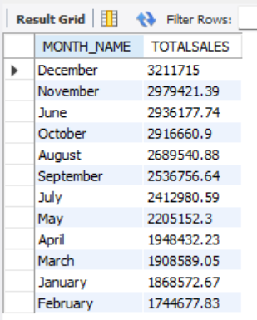
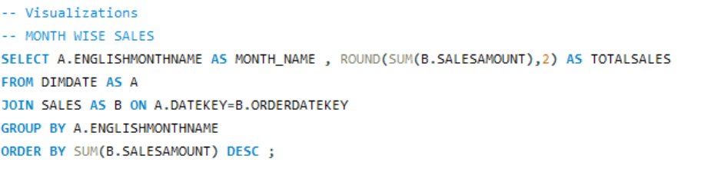
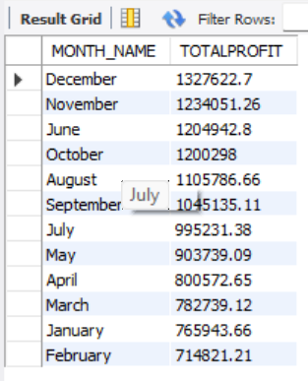
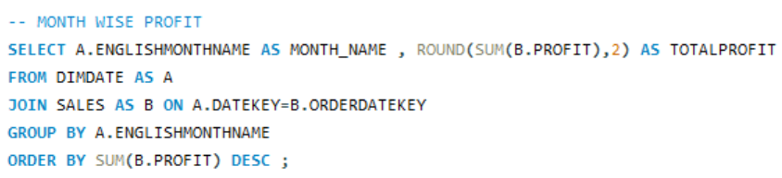
SQL QUERIES

Slide 14
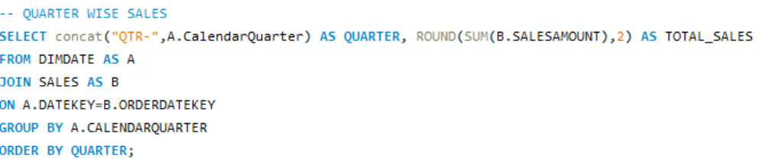
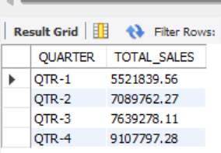
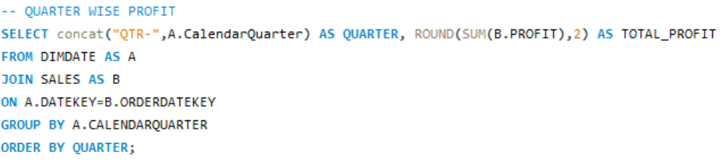
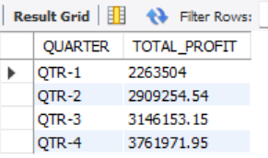
SQL QUERIES

Slide 15
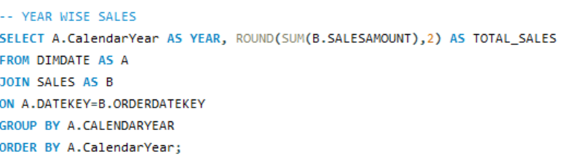
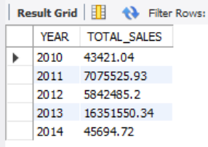
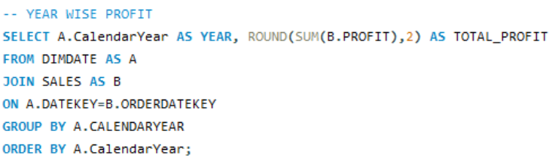
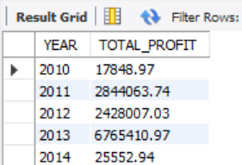
SQL QUERIES

Slide 16
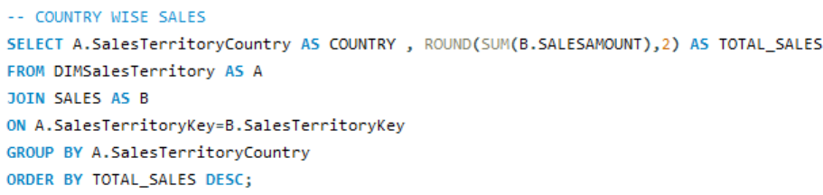
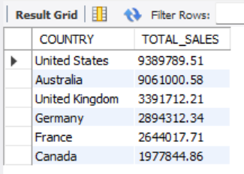
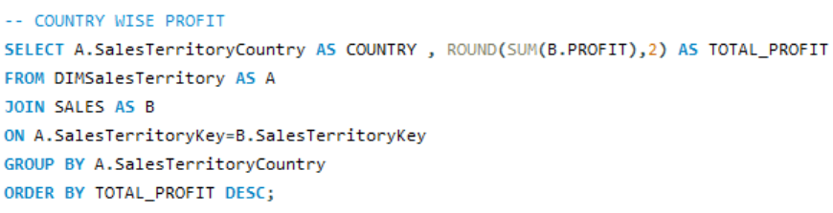
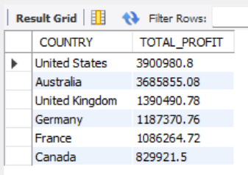
SQL QUERIES

Slide 17
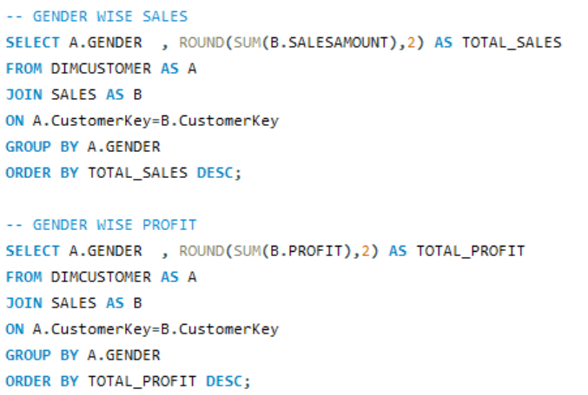
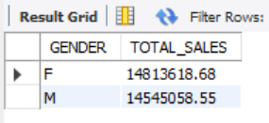
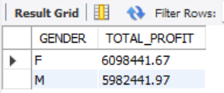
SQL QUERIES

Slide 18
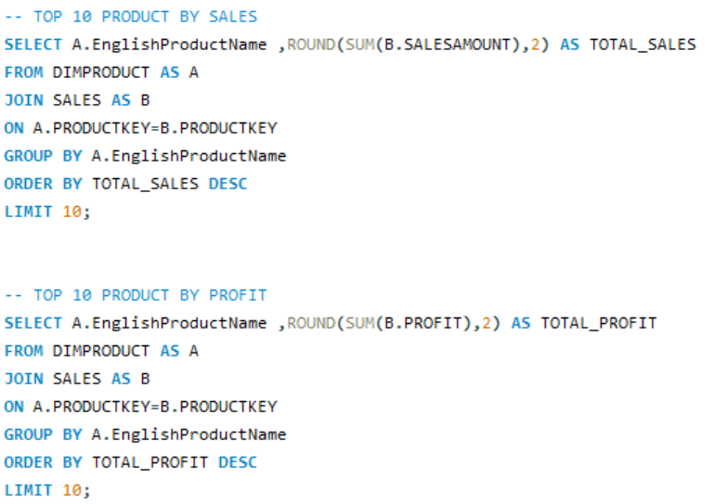
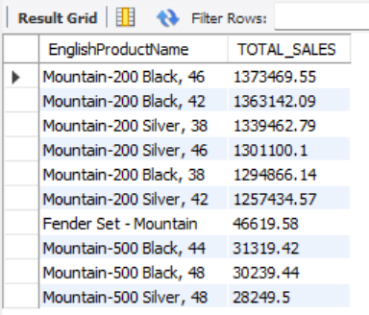
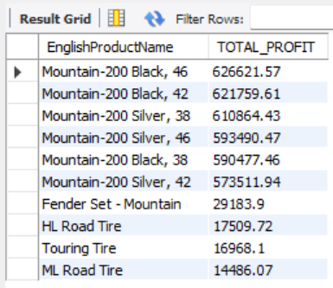
SQL QUERIES

Slide 19
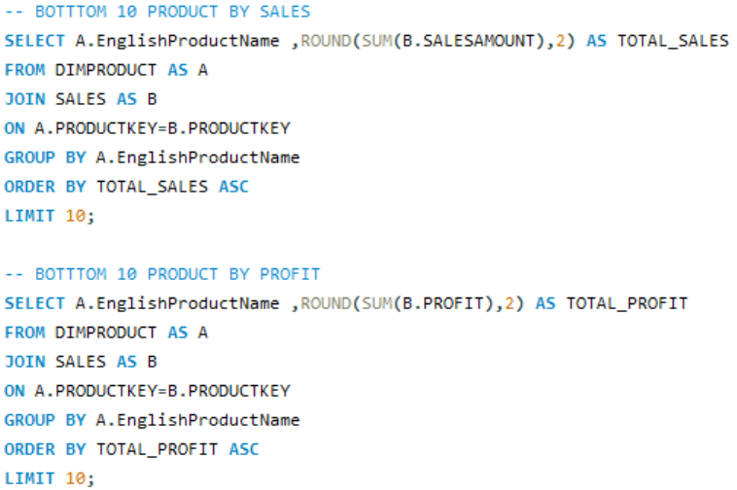
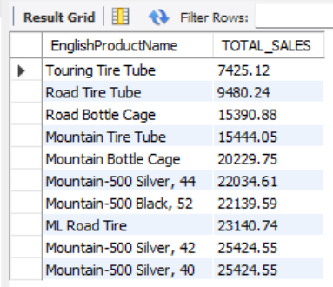
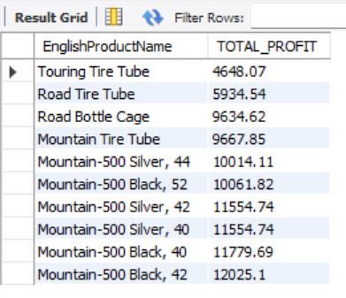
SQL QUERIES

Slide 20
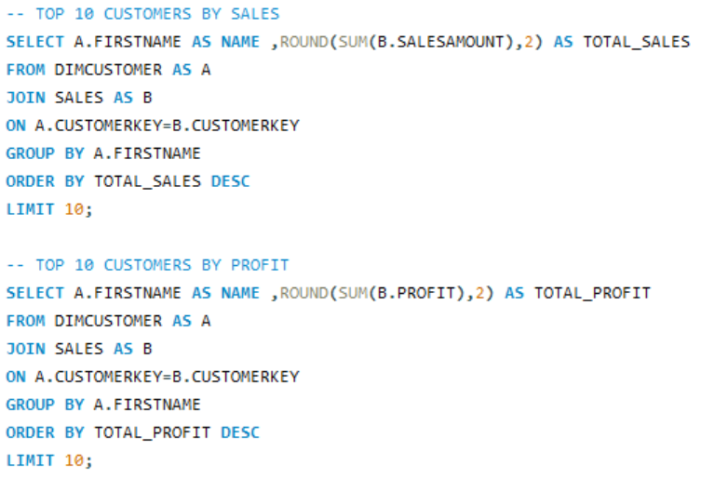
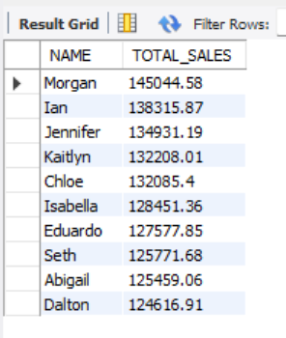
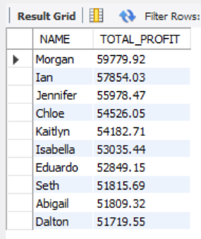
SQL QUERIES

Slide 21
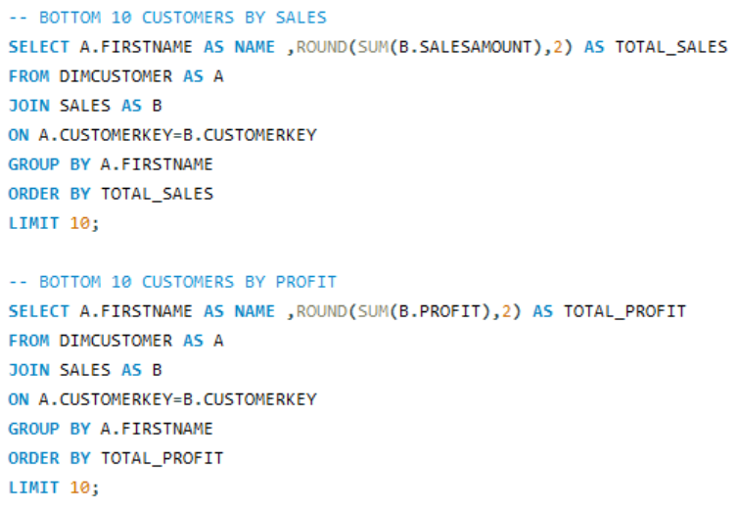
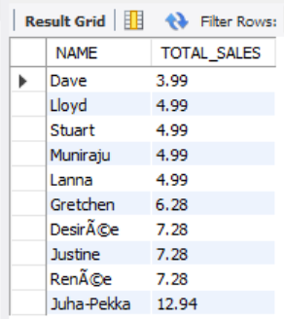
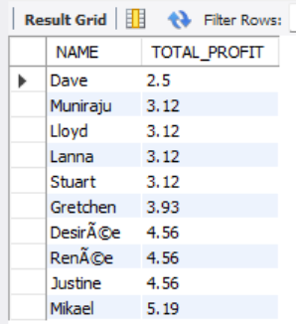
SQL QUERIES

Slide 22
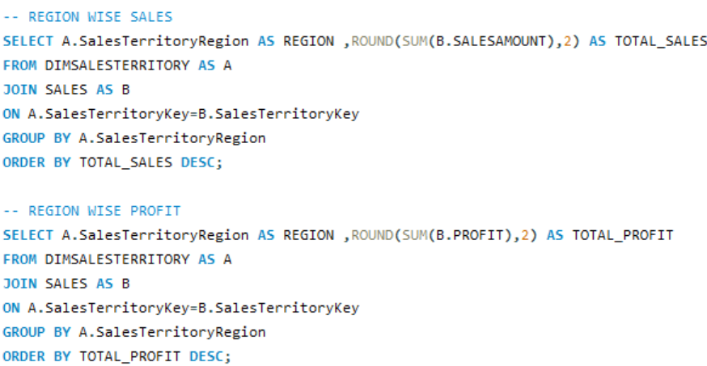
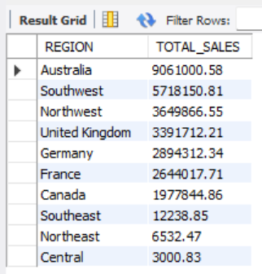
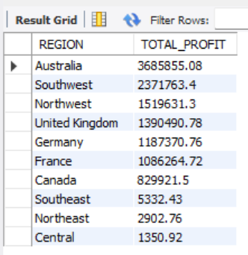
SQL QUERIES

Slide 23
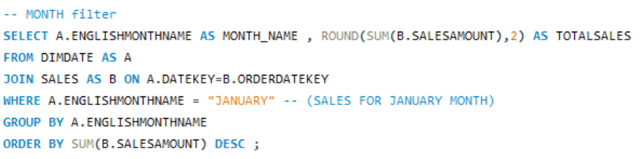
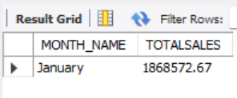


SQL QUERIES
SLICER (To filter results based on Quarter ,Month, Year , Country , we can use the WHERE clause in our queries. Below are some examples demonstrating its usage :-

Slide 24




SQL QUERIES

Slide 25

Insights
Best Year - 2013: 16.35M in sales
Top Quarter - Q4 : 9.11M in sales
Peak Months - 1. December: 3.21M in sales
2. November: 2.98M in sales
Top Products by Profit & Sales -
1. Mountain-200 Black, 46 → Profit 626K, Sales 1.37M
2. Mountain-200 Black, 42 → Profit 621K, Sales 1.36M
Top Customers - Morgan: Highest Sales 145K, Profit 60K
Top Regions –
1. Australia: Sales 9.06M, Profit 3.69M
2. Southwest: Sales 5.72M, Profit 2.37M
Top Countries -
1. United States: Sales 9.39M, Profit 3.90M
2. Australia: Sales 9.06M, Profit 3.69M
Gender-wise Sales -
1. Female : Sales 14.814M, Profit 6.098M
2. Male : Sales 14.545M, Profit 5.982M

Slide 26

Sales & Profit Boost Plan
✅ Maximize Peak Sales Periods
Strengthen Q4 promotions (November & December).
Introduce limited-time deals and product bundles.
✅ Reduce Production Costs
Lower expenses through supplier negotiations and automation.
Focus marketing efforts on high-margin products.
✅ Scale Up Best-Selling Products
Boost stock and promotions for Mountain-200 Black (sizes 46 & 42).
Encourage cross-selling with accessories and offer loyalty discounts.
🚀 Improve Low-Selling Products & Regions:
Bundle slow-moving items with popular products.
Target Central, Northeast, France & Canada with localized campaigns.
📈 Boost Low-Sales Months (Jan & Feb):
Launch winter sales & off-season discounts.
Promote indoor cycling & maintenance products.
🎯 Enhance Customer Engagement & Targeted Sales
Prioritize female customers, as they drive higher sales.
Reward loyal customers and personalize marketing strategies.
Goal: Increase revenue, reduce costs, expand reach.

Slide 27


THANK YOU …

